Slide 1

Cimberio Energy Valve
25/05/2022
CSxxxSC
Reserved and confidential

Slide 2
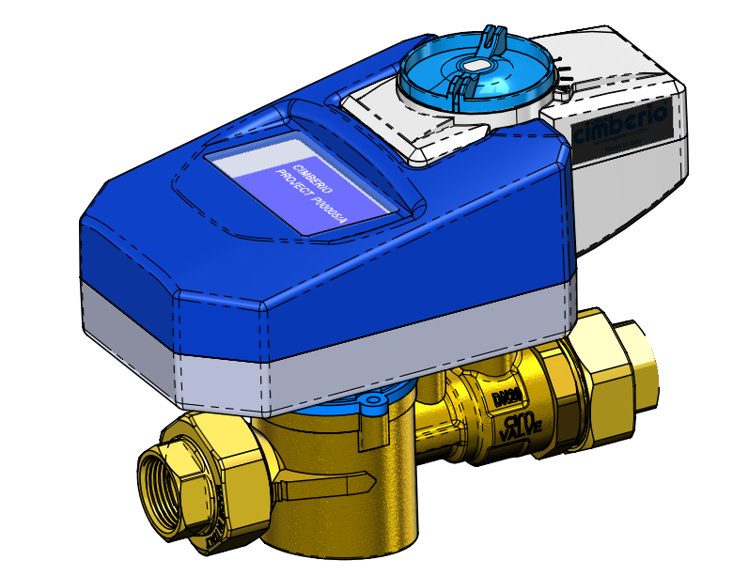
General features - This is it
Energy meter with integrated control valve
Building automation connectivity (BMS): Modbus, BacNet, MQTT
Measurement and control of:
  Flow
  Differential ΔT(T1-T2)
  Flow temperature (T1)
  Return temperature (T2)
  Power
  Valve position
  MID certification compatible (Flow and Energy)
Embedded electronic control unit
Reserved and condifential

Slide 3
Concept – Quick look
Energy valve,
main components:
Electromagnetic flow meter
Temperature sensors
Electronic control unit
Regulating valve
Valve Actuator
Reserved and condifential

Slide 4
Electromagnetic flow meter
Features:
High accuracy flow measurement;
Glycols in the water do not affect the flow measurement;
Less prone to problem in case of air bubble in the network
Reserved and condifential

Slide 5
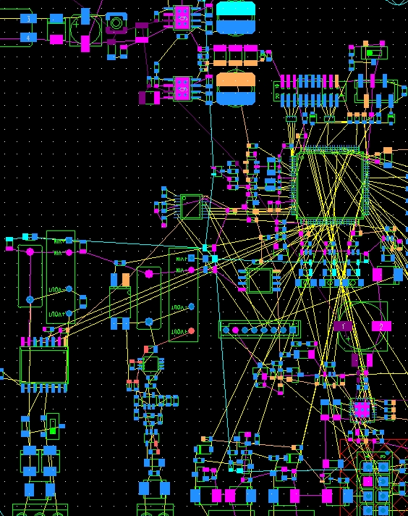
Electronic control unit
Features:
Building automation connectivity
Enersem Cloud compatible
BMS compatible
Modbus and other protocols
Heating and cooling energy counters
Accurate flow measurement
T1, T2, ΔT measurement
Power and Energy measurement
Ethernet port
Serial port RS485
USB port (service)
Display (optional)
Reserved and condifential

Slide 6
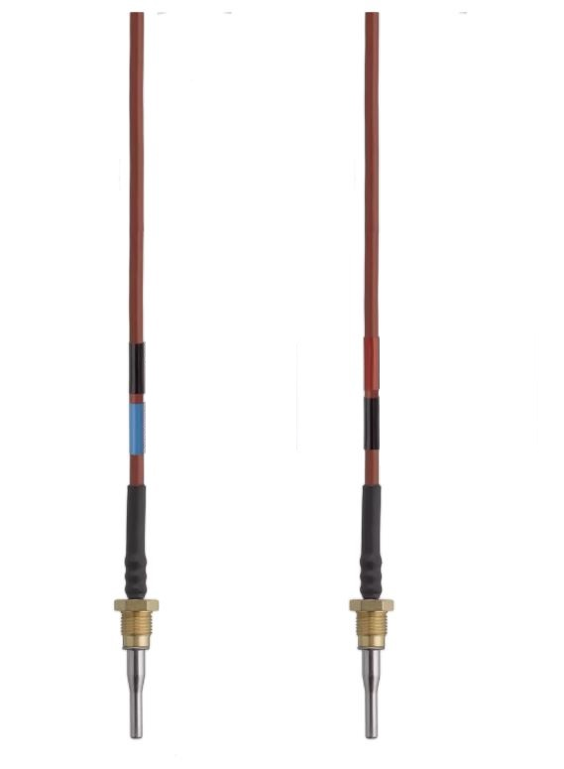
Temperature sensors
Features:
Connection: screw connection
Paired calibration
Type: Pt500/Pt1000;
N° wires: two-wire
Temperature range: 0 to 180 °C
Maximum pressure: PN 25
Protection type: IP65
Reserved and condifential

Slide 7
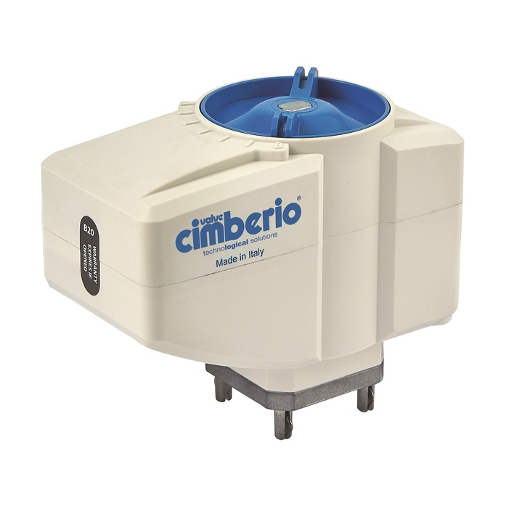
Valve Actuator
Features:
Voltage: 24V-50/60 Hz AC/DC;
Rotation angle: 90°;
Opening/closing time: 60’’
Control: proportional
Protection degree: IP54
Operating torque: 10 Nm
Position: measure of valve opening degree;
Position indicator: knob on cover
Manual operation: yes
Reserved and condifential

Slide 8
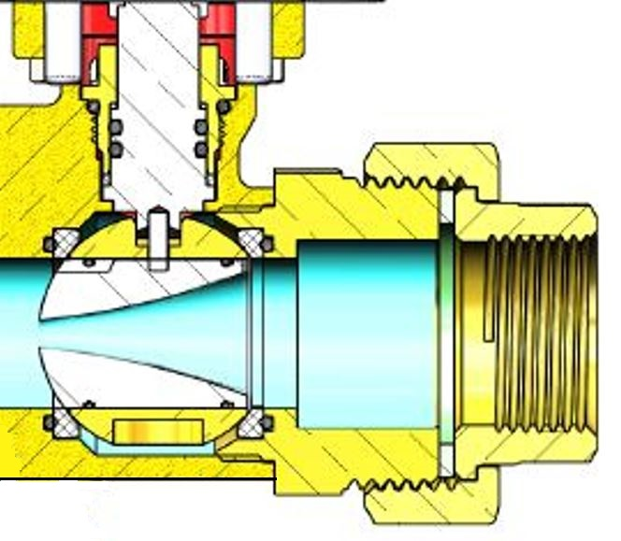
Valve body and regulating valve
Features:
Body made of dezincification resistant brass
Size range: DN15÷DN50
PN25
Thermodynamic parameters measurement
Equipercent characterized
ball valve
Reserved and condifential

Slide 9
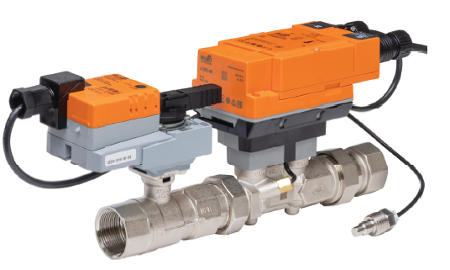
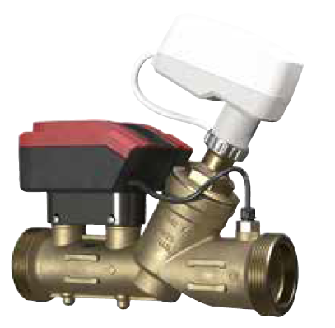
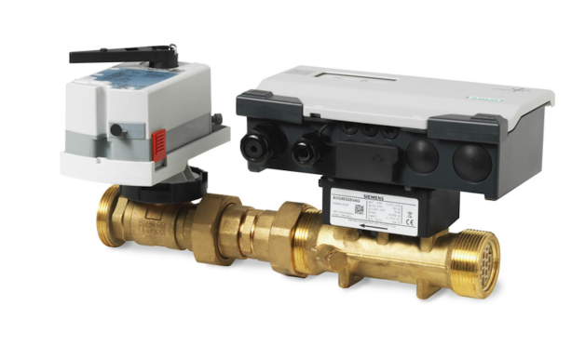
Comparison
CIMBERIO | BELIMO | TOUR ANDERSON | SIEMENS
Electromagnetic | Ultrasonic | Ultrasonic | Ultrasonic
Compact Single piece | No single piece | Single piece | No single piece
½» - 2» | ½» - 2» | 1»1/4 – 2» | ½» - 2»
MODBUS BACNET MQTT | MODBUS BACNET | MODBUS BACNET MQTT | MODBUS BACNET
Characterized ball valve | Characterized ball valve | Globe | Characterized ball valve

Slide 10
Thank you for your attention

Slide 11
Block diagram – inside look
Heat exchangers
Flow
T1 temperature sensor
Flow
Heat generator
Electronic control unit
Electrical actuator
Flow meter
T2 temperature sensor
Regulating valve
Flow
Flow
T1 = flow temperature sensor
T2 = return temperature sensor
Reserved and condifential

