Slide 1
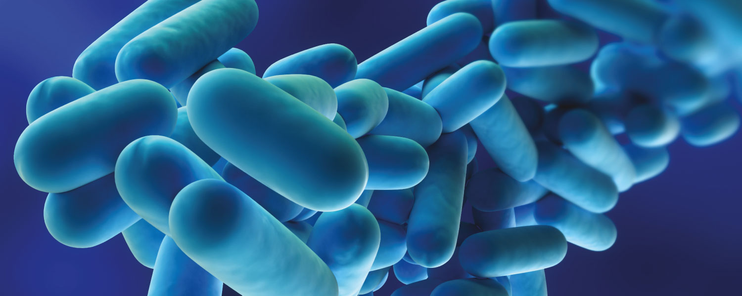
Effective prevention from Legionella bacteria

Slide 2

What is it?
Legionnaire's disease is an infectious disease that affects the respiratory system.
Legionellas prefer natural and artificial reservoirs, and temperatures between 25 and 55 °С.
Confidential

Slide 3
High
temperature
Required
temperature
Low
temperature
Insufficient
temperature
Confidential

Slide 4
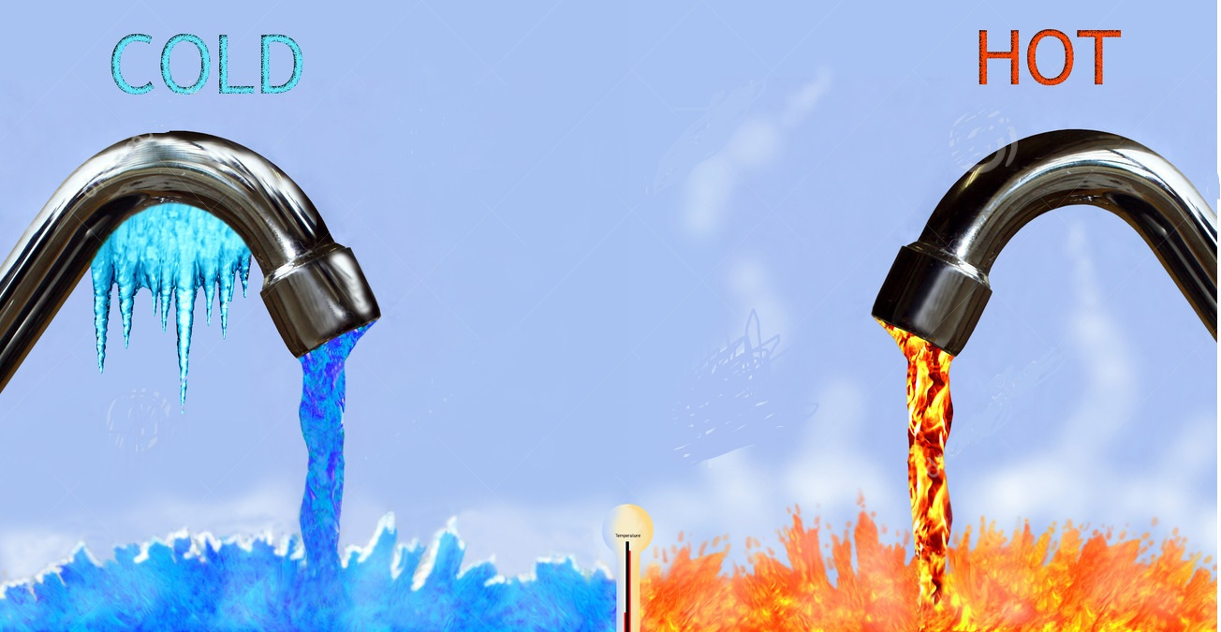
WHICH ARE THE MAIN PROBLEMS?
-From low temperatures
-From high temperatures
Confidential

Slide 5
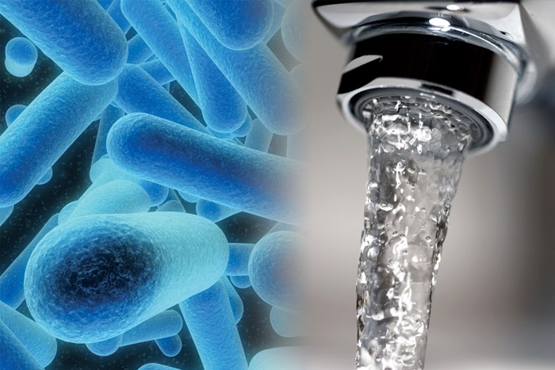



From low temperatures
Risk of Legionella
Energy costs
Waiting time of hot water
Waste of water
Confidential

Slide 6

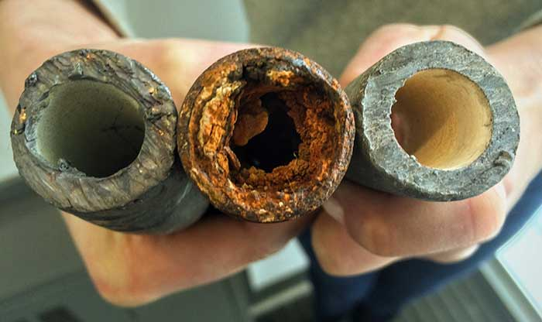
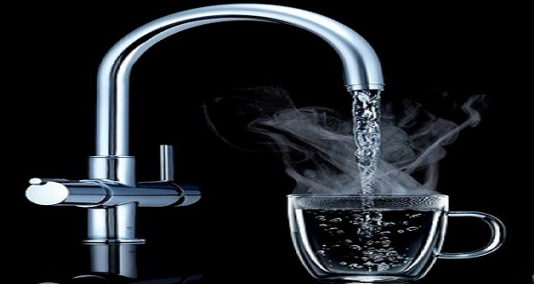
From high temperatures
Waste of energy
Corrosion and limescale
Burning of hot water
Confidential

Slide 7
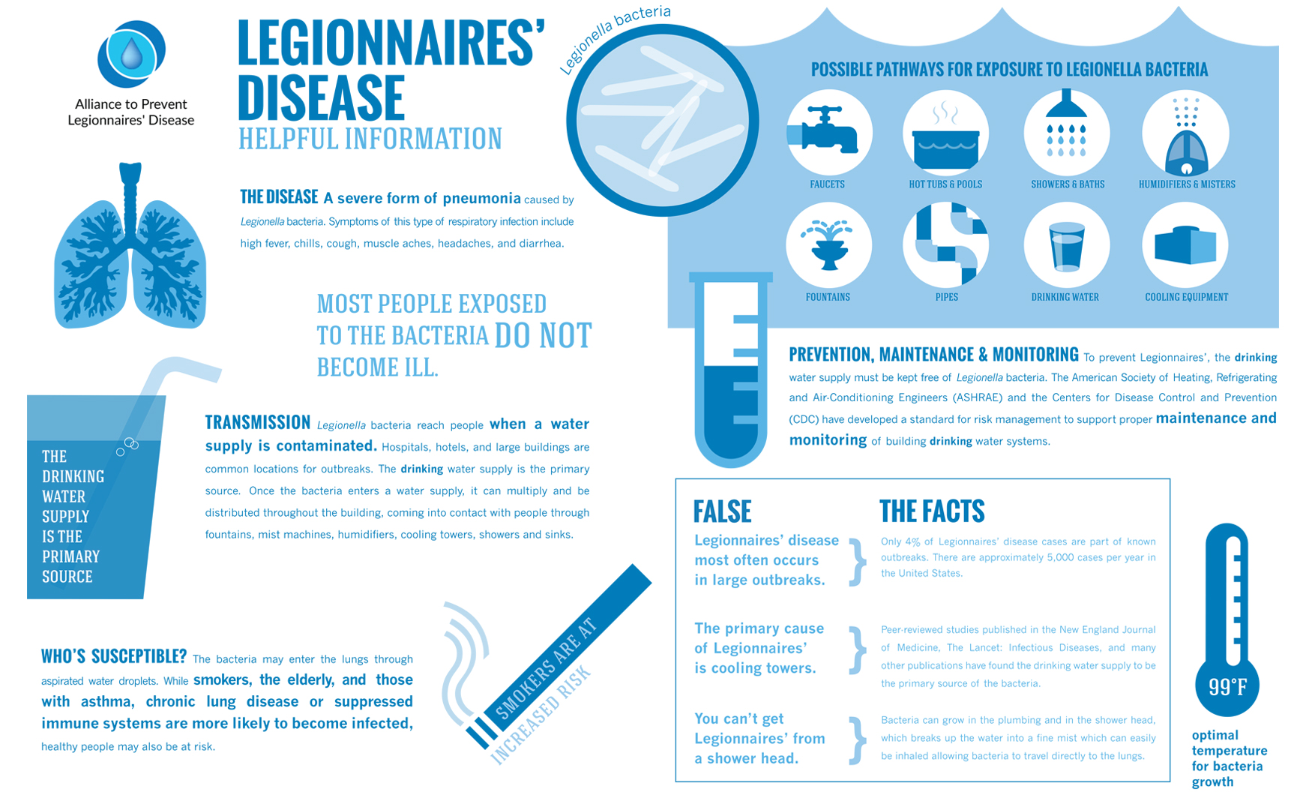

Slide 8

Confidential

Slide 9

SOLUTION?
-
Chemical methods(chlorination, ozoning. Both influence negative on the water quality and corrosion)
Physical methods(thermal disinfection, ultravioletlight)
High temperatures is by far the easiest and most reliable way to disinfect the system(65ºC kills all bacteria in ~10 minutes)
Confidential

Slide 10
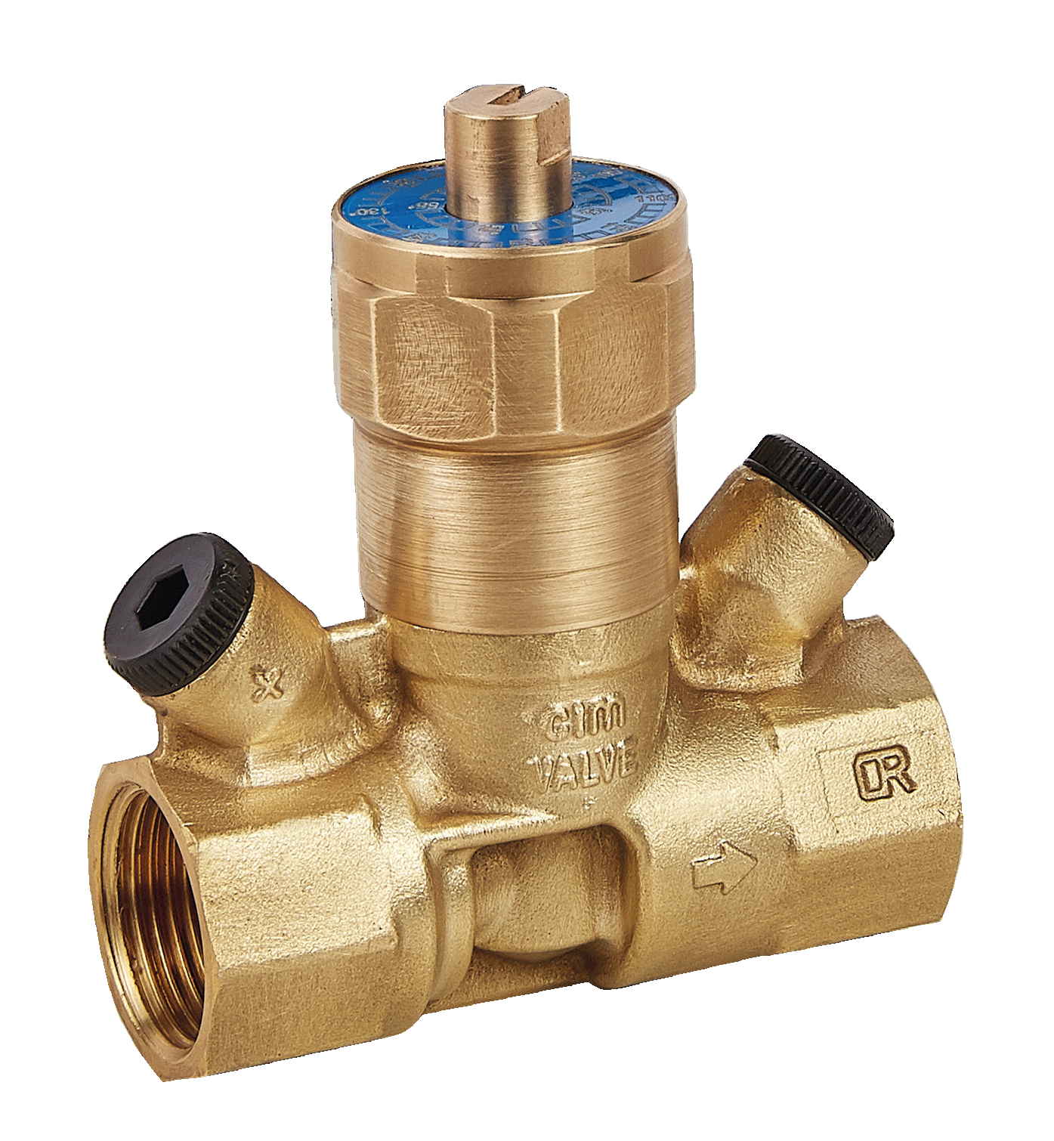
Cim 778
Thermostatic regulator
For domestic hot water recirculation loops
With disinfection function against LEGIONELLA
Confidential

Slide 11
Features
The thermostatic regulator, installed on each branch of the recirculation circuit, automatically maintains the set temperature. This device modulates the medium flow rate in accordance with the water inlet temperature by means of the action of a dedicated internal thermostatic cartridge.
It is also equipped with a by-pass mechanism, to be used in the event of thermal disinfection against Legionella.
Confidential

Slide 12
Operating principle
When the water temperature approaches the set value, the obturator progressively reduces the passage. The medium flow rate supplied by the recirculation pump is thus distributed to the other network branches, resulting in effective automatic thermal balancing.
If necessary, the regulator is already designed with a thermal disinfection function, which is useful if the system temperature is to be increased to values over 55–60°C (130-140 °F). This function is completely automatic, activated by the inner sensor that opens a by-pass at ≂70°C (≂160°F).
Confidential

Slide 13
Setting
Setting of required Temperature with scale dial.
Confidential

Slide 14
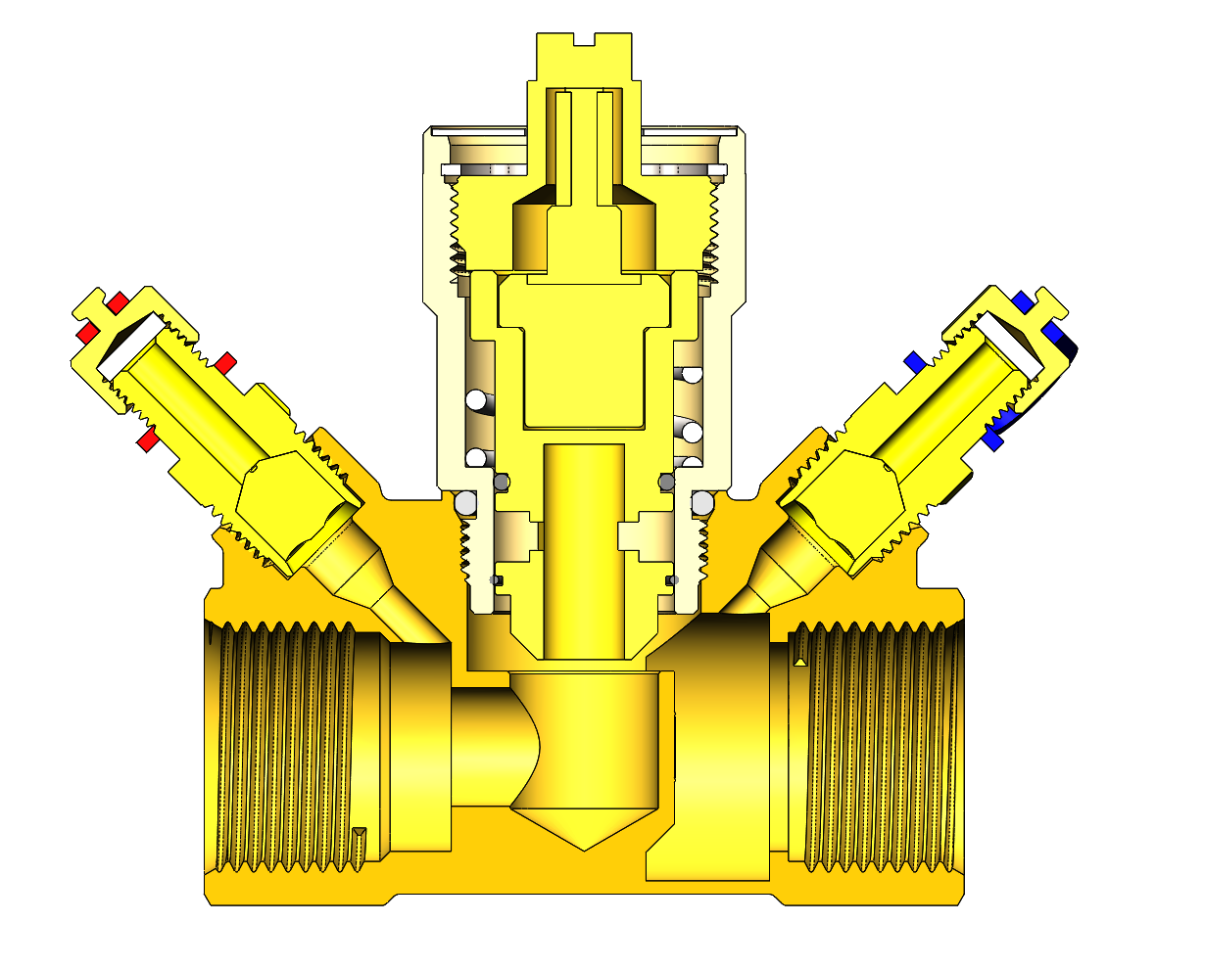
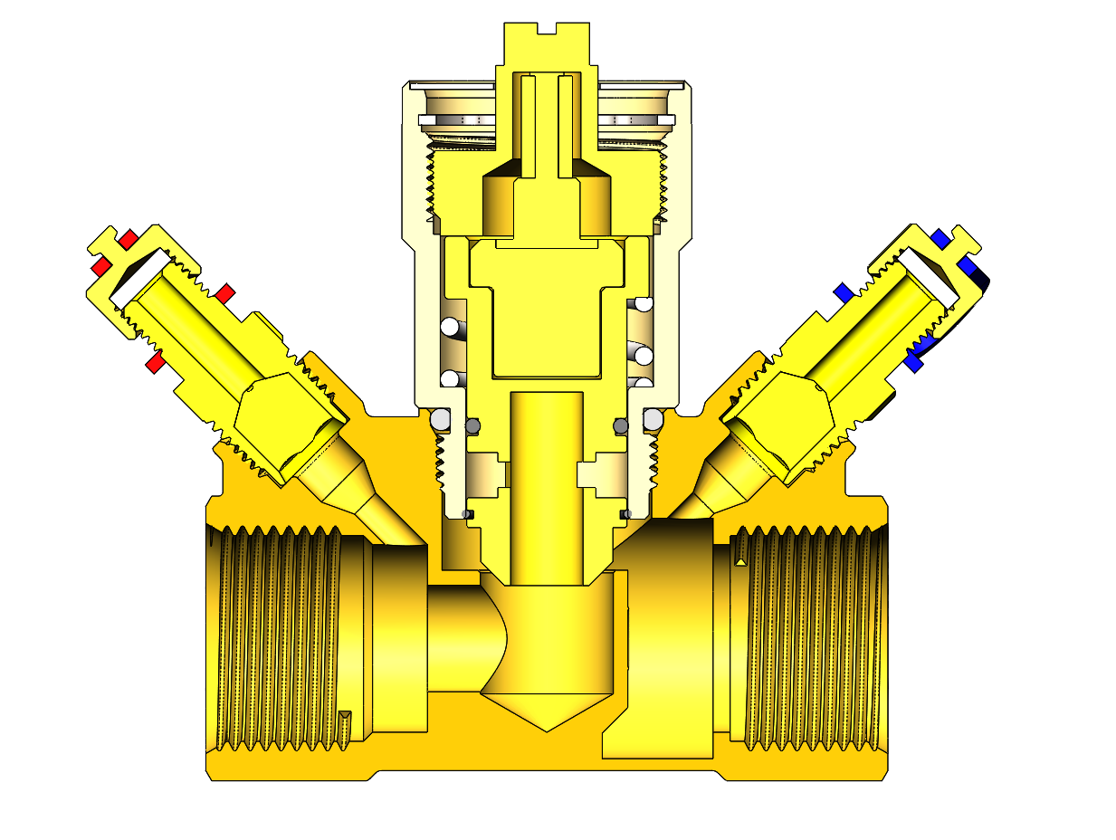
Temperature control
Water at setting temperature = minimum flow
Cold Water = max flow
*binder points are optional
Confidential

Slide 15
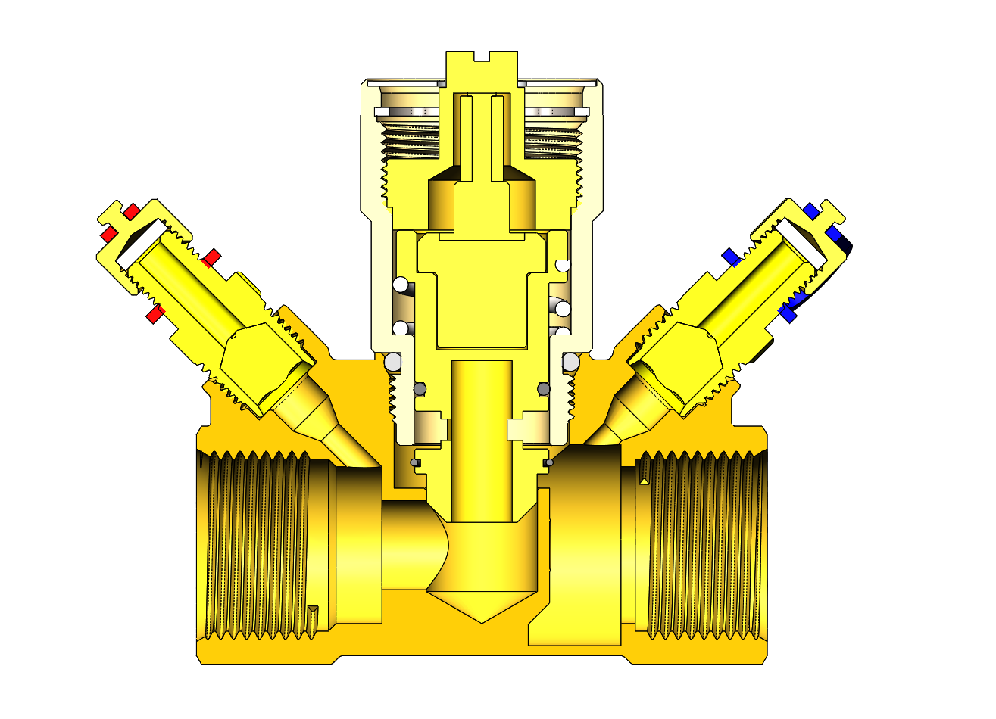
Disinfection against Legionella
Water at ≂70°C (≂160°F).
= disinfection against legionella =By-Pass
*binder points are optional
Confidential

Slide 16
Flow rates
Example
Setting 51 °C
Confidential

Slide 17
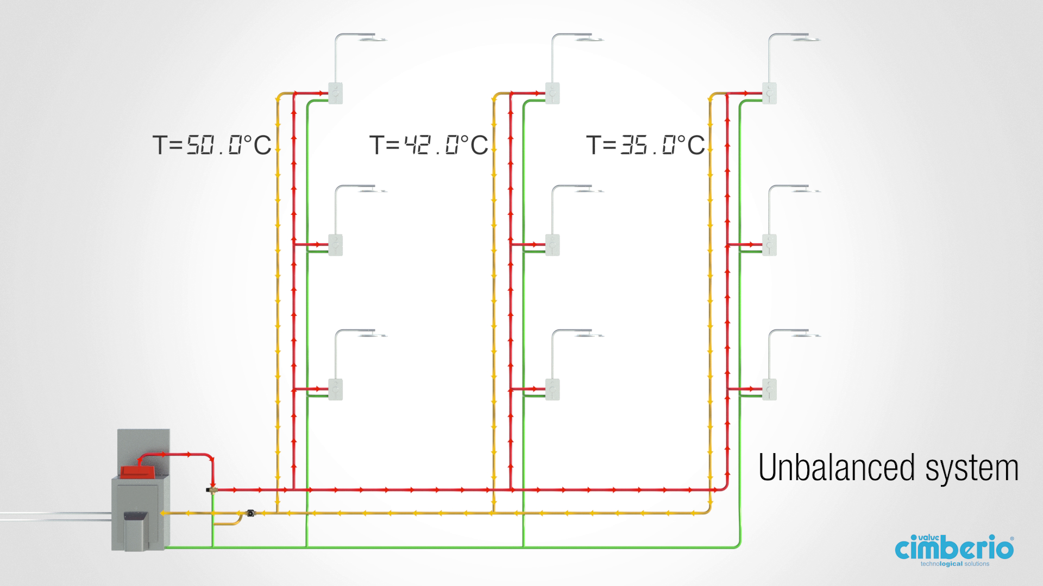
Typical installation – without Cim 778

Slide 18
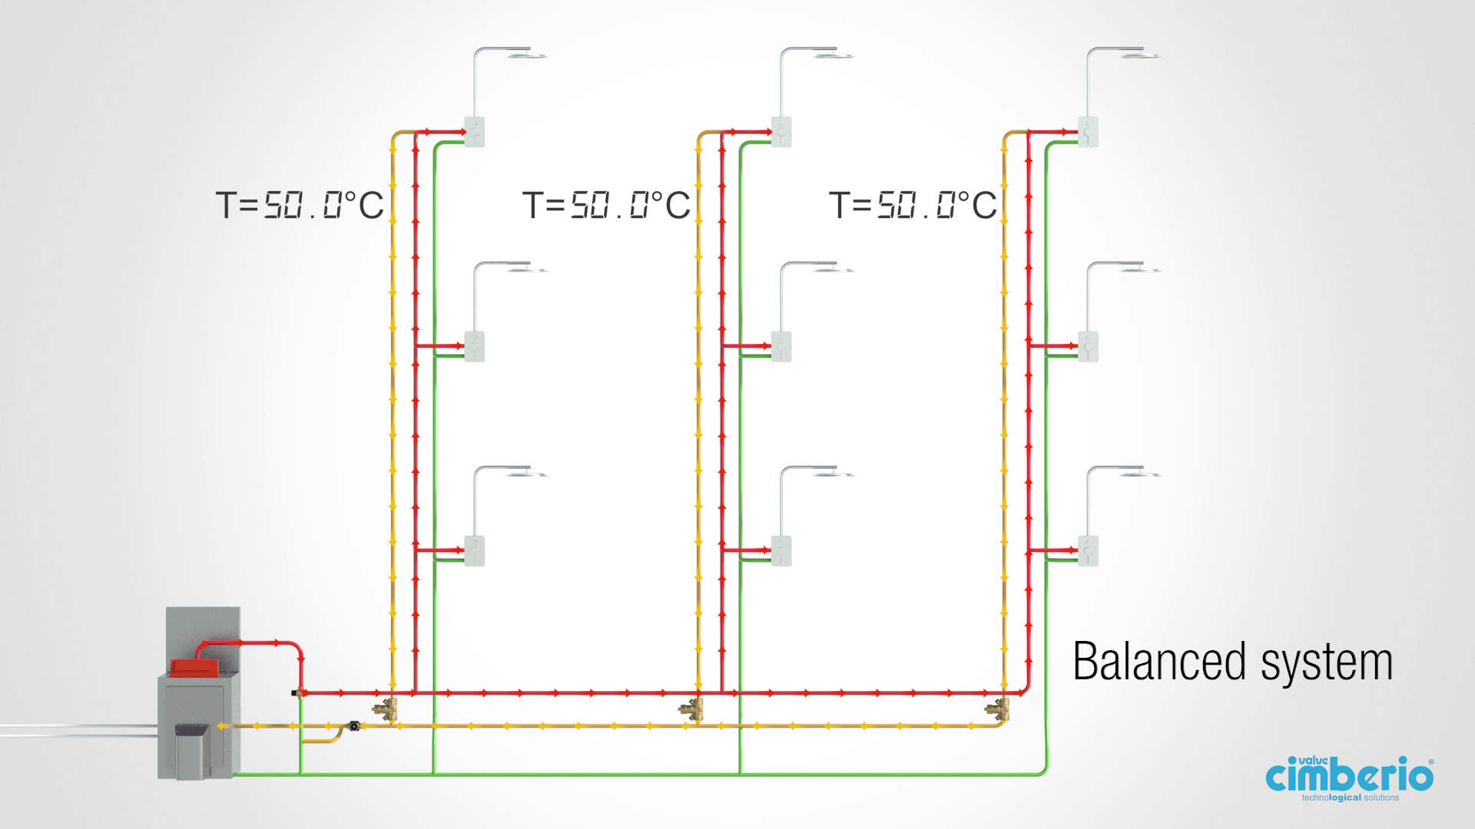
Typical installation – with Cim 778

Slide 19
Benefits
Easy temperature adjustment;
Energy saving thanks the auto-balancing feature
Built-in disinfection function to protect against legionella
Available in 3 sizes (1/2”,3/4”,1”) for different flow rates
DZR Brass body
Confidential

Slide 20
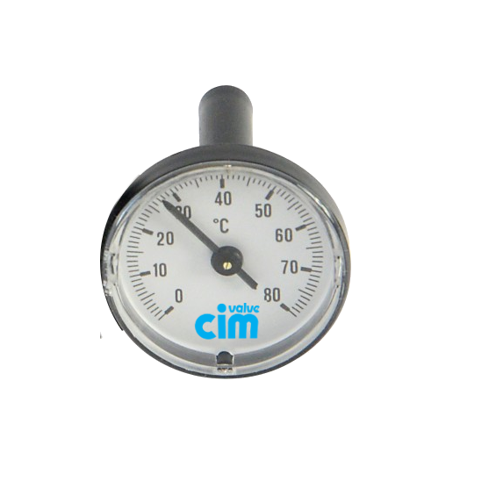
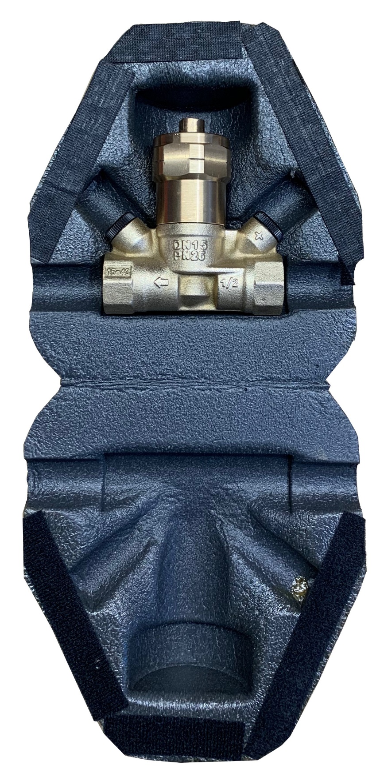
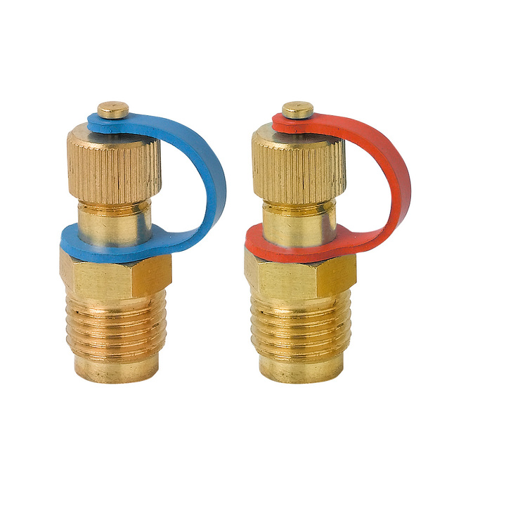
Accessories
Cim 999CS - Thermometer
Cim 723L – Binder points
Cim 728C –Insulating case

